Slide 1
ACME Pharmaceutical HR Visualization
Student :
Teacher: Kate Goldberg

Slide 2
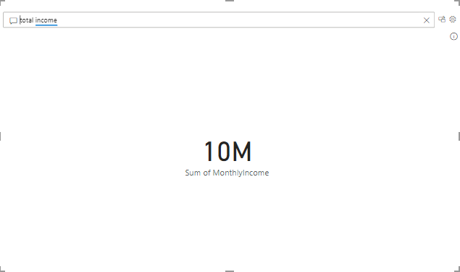
By adding up the monthly income of the employees we obtain an income over the year which is 10M.

Slide 3
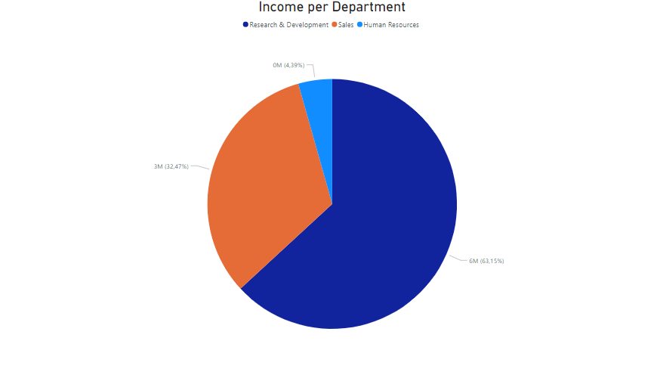
Human ressources departement represents 4.39% of income.
We then find the income per department and it appears that:
The department of Research & Development represents 63.15% of income.
The sales department represents 32.37% of income.

Slide 4
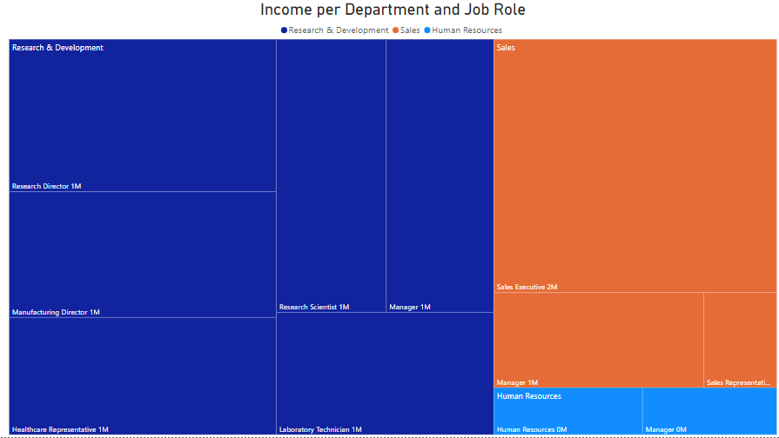
The jobs with the most income by department are:
Research Director for Research & Development department.
Sales executive for the sales department.
Manager for the Human ressources departement.

Slide 5
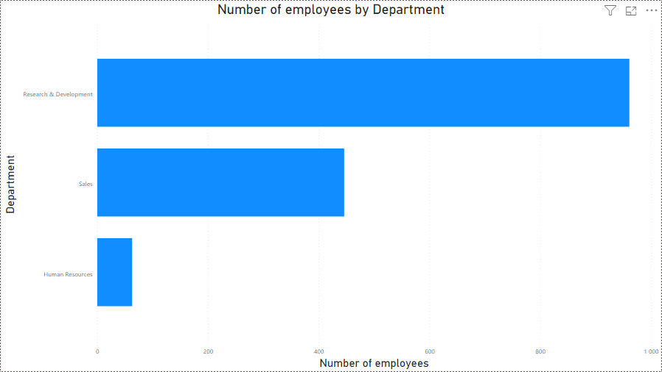
We explore the number of employees per department. And we see that the number of employees is proportional to the total income per department.

Slide 6
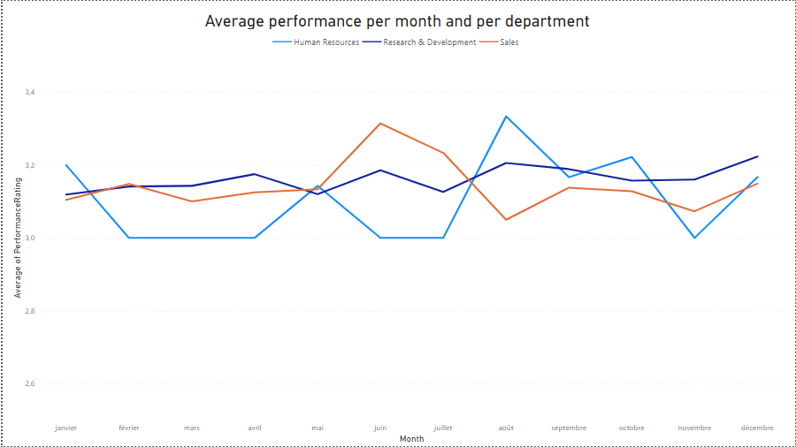
Each of the departments have similar performances over time.
This is what we can see in this graph which shows the average performances per month of each department

Slide 7
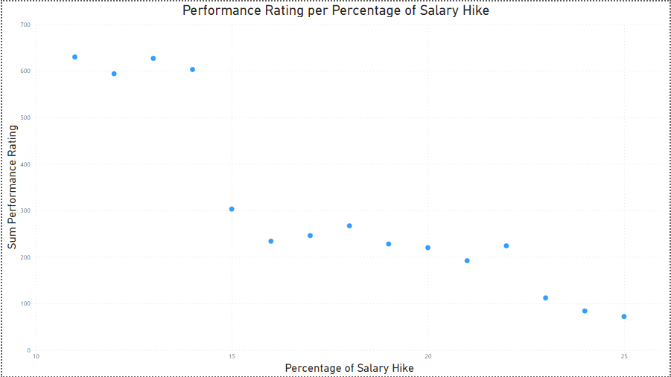
We visualize sums of performance according to the percentage of increase of employees. At first glance one might believe that the higher the increase, the performance decreases. But actually, no. This chart shows that relatively few employees get significant raises

Slide 8
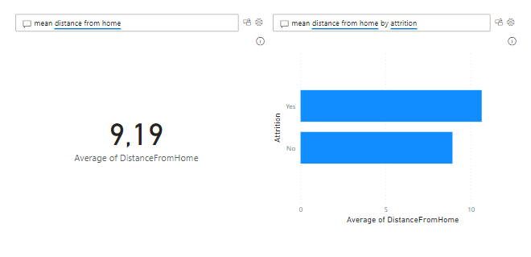
The average distance from home of employees is 9.19. If we consider that the average distance of employees who leave their job is greater than 9.19. We can conclude that the distance from home affect the attrition of employees.

Slide 9
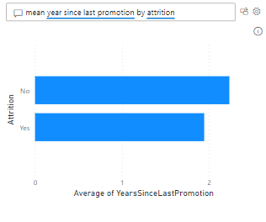
We check whether the spent whithin the company without obtaining promotion is the basis for employees leaving. But the average number of years spent without promotion for employees who stay is greater than for those who leave. So this parameter does not have a big influence.

Slide 10
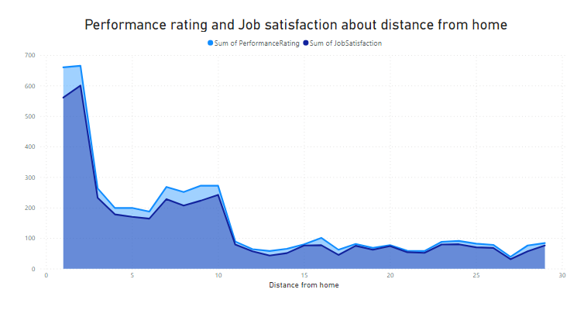
Job satisfaction and performance are linked to distance from home. But can also mean that there are not many employees located a long distance from the company.

Slide 11
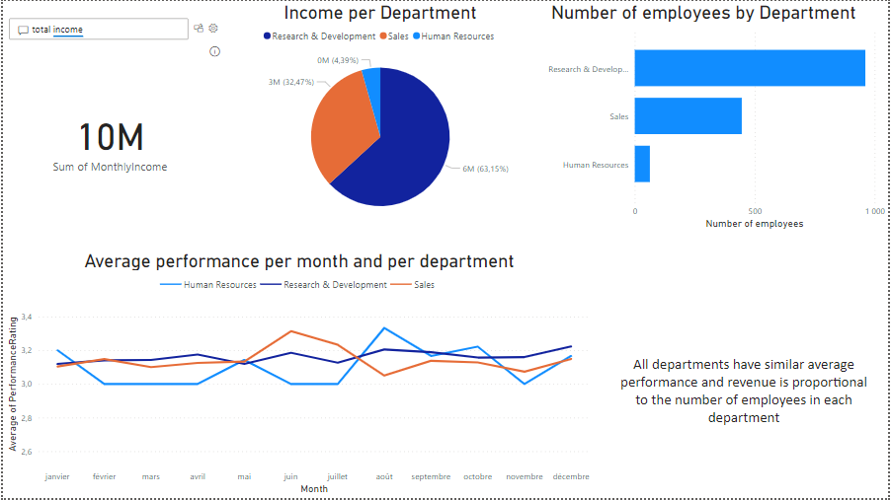
Notes:
What is the company’s total revenue during the year? By adding the monthly income we obtain 10M.
Given the number of employees and even the income per department one might wonder if performance is proportional? But this is not the case, performance are almost similar by department over time.

Slide 12
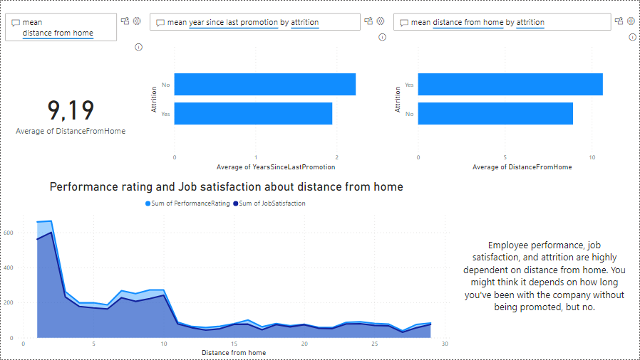
Notes:
What is the average distance from home of employees?
Does the time spent without promotion influence the attrition of employees?
Does performance, job satisfaction, and distance from influence employee attrition?

Slide 13
Recommendations
Help employees located a long distance from the company, financially for example, through a small travel bonus. But to avoid all employees moving miles away, this bonus should be provided for all employees.
Avoid hiring more employees located very far from the company in the future.
Very few employees manage to obtain significant increases, we should think about changing this.

